Slide 1
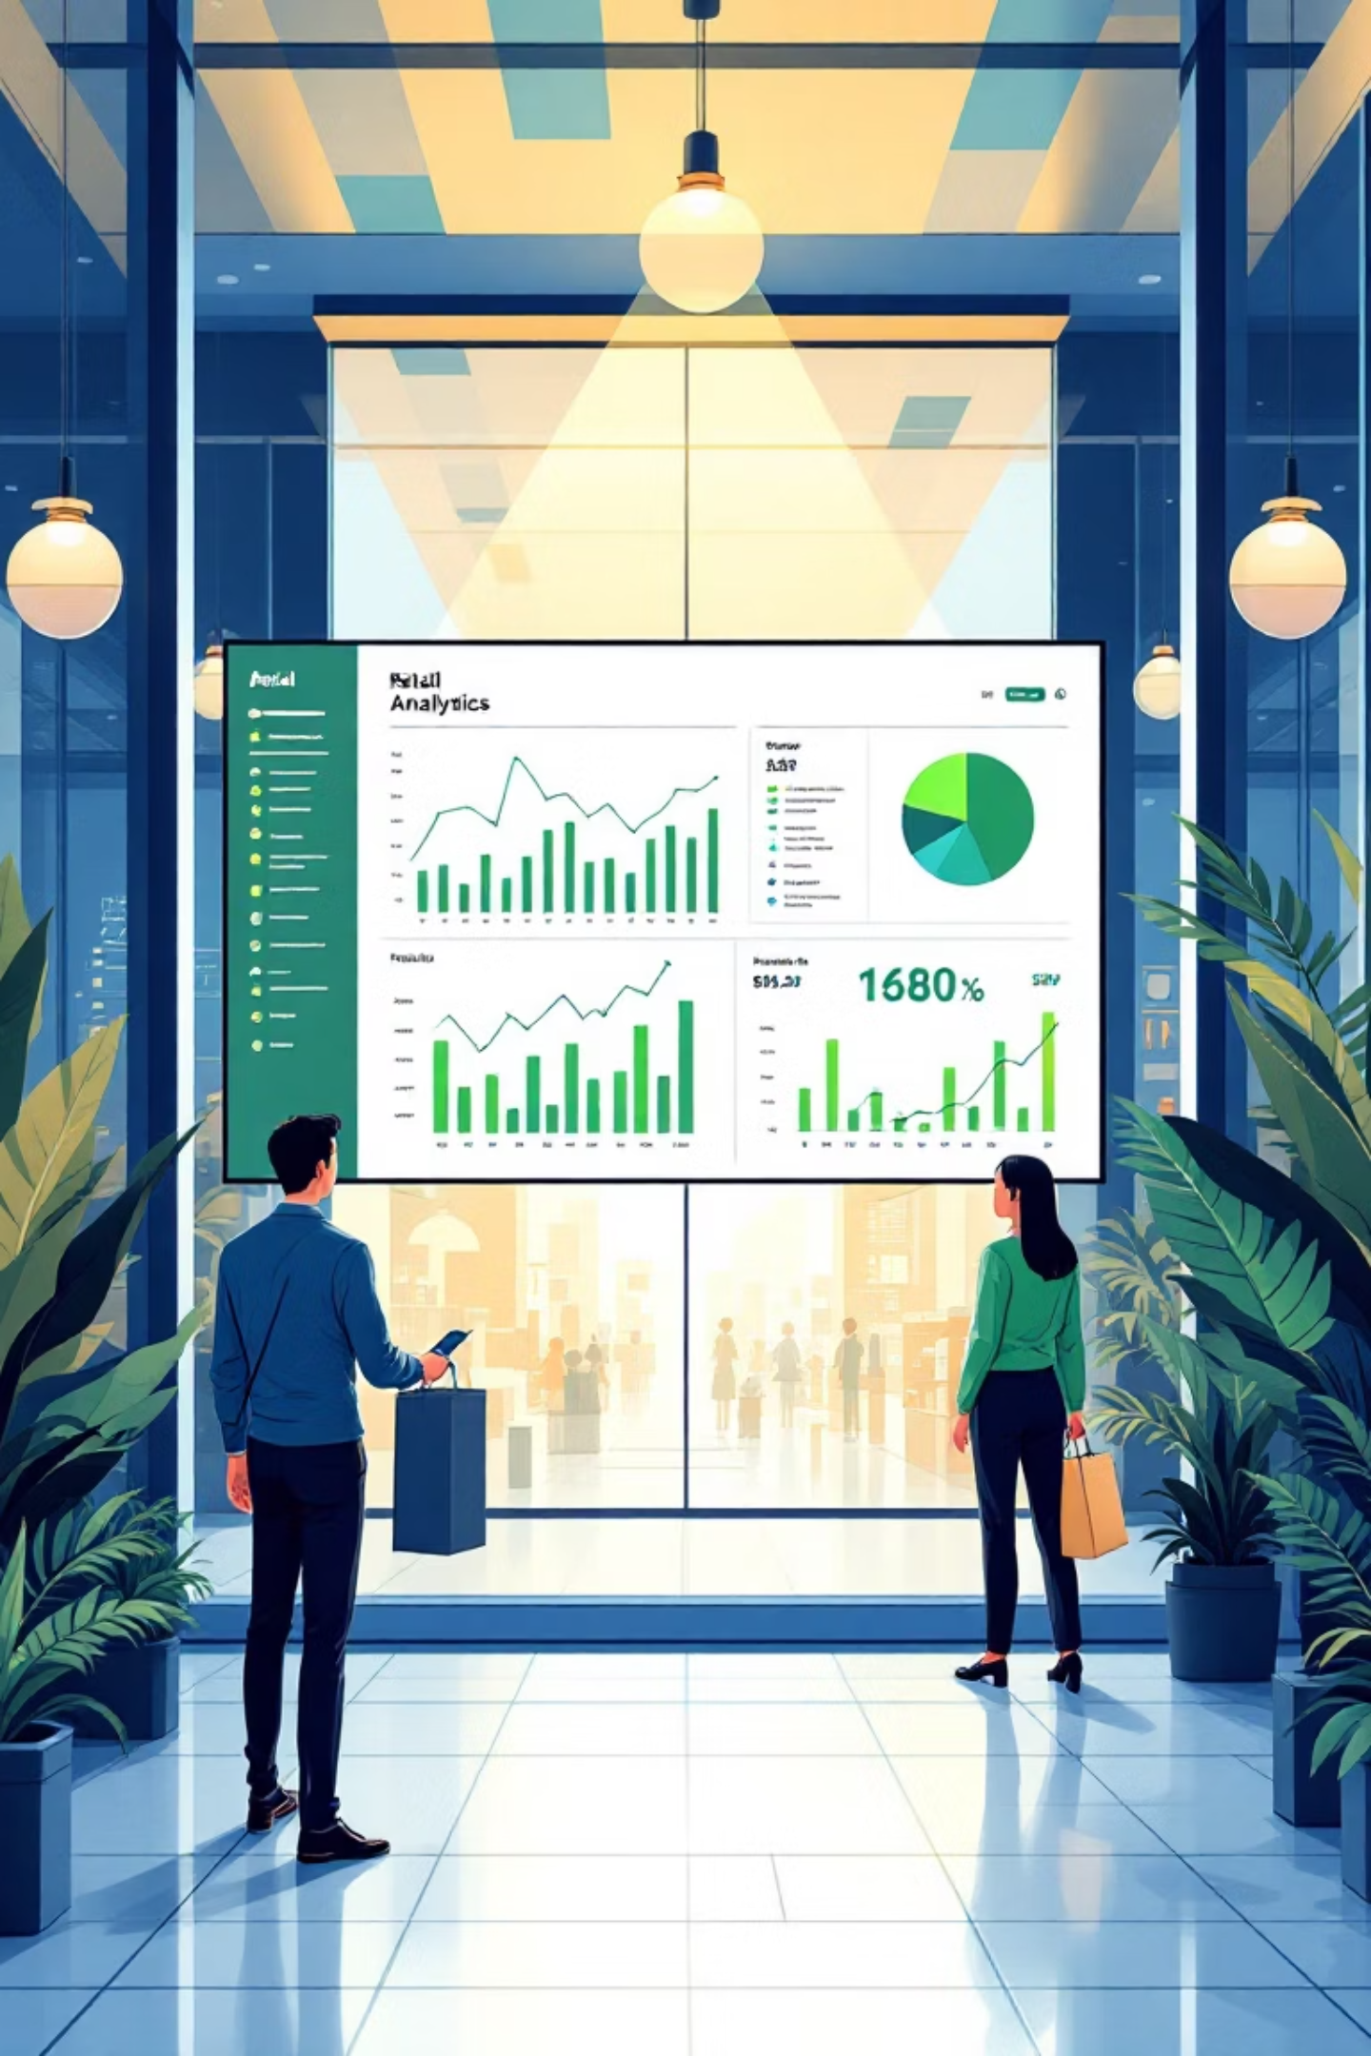
Customer Shopping Behavior Analysis
Uncovering insights from 3,900 purchases to guide strategic business decisions through data-driven analysis of spending patterns, customer segments, and product preferences.

Slide 2

Dataset Overview
3,900
18
$59.76
Total Purchases
Data Points
Avg Purchase
Features covering demographics and behavior
Mean transaction value across all customers
Transactions analyzed across all categories
3.75
Avg Rating
Customer satisfaction score out of 5
Key features include customer demographics, purchase details, shopping behavior patterns, and subscription status across 50 locations.

Slide 3

Data Preparation & Cleaning
Python Analysis Steps
Database Integration
Loaded dataset using pandas for exploration
Connected Python to PostgreSQL and loaded cleaned data for structured SQL analysis. This enabled efficient querying of business transactions and customer behavior patterns.
Imputed 37 missing Review Rating values using median by category
Standardized columns to snake case format
Created age_group and purchase_frequency_days features
Dropped redundant promo_code_used column

Slide 4

Revenue Insights
Male Customers
Female Customers
$157,890 total revenue
$75,191 total revenue
68% of total revenue generated
32% of total revenue generated
High-Spending Discount Users
Identified 839 customers who used discounts but still spent above the $59.76 average purchase amount, indicating price-conscious yet high-value shoppers.

Slide 5
Top-Rated Products
1
2
3
Gloves
Sandals
Boots
Average rating: 3.86
Average rating: 3.84
Average rating: 3.82
4
5
Hat
Skirt
Average rating: 3.80
Average rating: 3.78
Express shipping customers spend $60.48 on average versus $58.46 for Standard shipping, suggesting premium service users have higher purchase values.

Slide 6
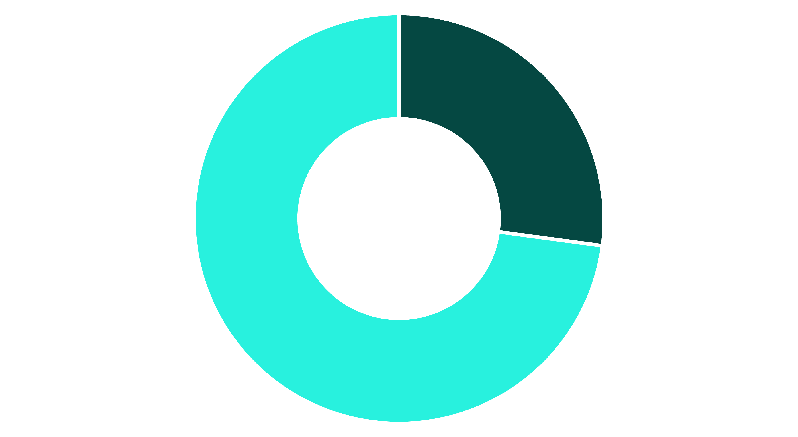
Subscription Analysis
Subscribers
Non-Subscribers
Subscribers
Non-Subscribers
Key Finding
1,053 customers
2,847 customers
Only 27% subscribe despite similar spending patterns, indicating significant growth opportunity.
Avg spend: $59.49
Avg spend: $59.87
Revenue: $62,645
Revenue: $170,436

Slide 7



Customer Segmentation
New
1
83 customers
Returning
2
701 customers
Loyal
3
3,116 customers
The majority of customers (80%) fall into the Loyal segment, demonstrating strong retention. However, 958 repeat buyers with 5+ purchases remain unsubscribed, representing untapped subscription potential.

Slide 8
Category Performance
Clothing
Accessories
Footwear
Outerwear
Top sellers: Blouse, Pants, Shirt
Top sellers: Jewelry, Sunglasses, Belt
Top sellers: Sandals, Shoes, Sneakers
Top sellers: Jacket, Coat
Hat leads discount dependency at 50%, followed by Sneakers (49.66%) and Coat (49.07%), suggesting these products require promotional support to drive sales.

Slide 9
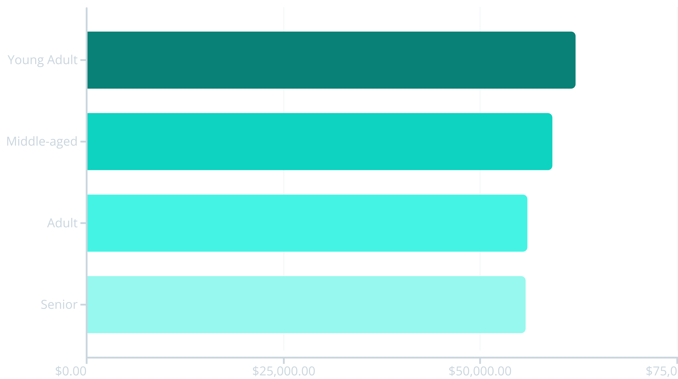
Age Group Revenue Distribution
Young Adults generate the highest revenue at $62,143, followed closely by Middle-aged customers. Revenue distribution is relatively balanced across age groups, suggesting broad market appeal.

Slide 10





Strategic Recommendations
Boost Subscriptions
Promote exclusive benefits to convert the 73% non-subscriber base, especially the 958 repeat buyers.
Loyalty Programs
Reward repeat buyers to accelerate movement from Returning to Loyal segment.
Review Discount Policy
Balance promotional sales with margin control, especially for high-discount products like Hats and Sneakers.
Product Positioning
Highlight top-rated products (Gloves, Sandals, Boots) and best-sellers in marketing campaigns.
Targeted Marketing
Focus on Young Adults and express-shipping users who demonstrate higher purchase values.

